Slide 1


TEAM
Mousimi Das
Gangavarapu Gayatri
Pandranki Narendra Babu
Riti Swapna Sri Behara
Pedapolu Sai
Team ID : LTVIP2023TMID09304

Slide 2
COMPREHENSIVE DIGITAL MARKETING
TOPIC
FABINDIA

Slide 3

Part 1: Brand study, Competitor Analysis & Buyer’s/Audience’s Persona
Research of Brand Identity:
Brand’s Mission: They will give their customers products that delight them by interpreting their rich heritage and traditional knowledge, while protecting the natural environment.
Brand’s Values: To remain true to their company's history and their founder's original Vision: "In addition to making profits, their aims are constant development of new products, a fair, equitable and helpful relationship with their producers, and the maintenance of quality on which their reputation rests.”
Brand’s Vision: Fabindia links over 55,000 craft based rural producers to modern urban markets, thereby creating a base for skilled, sustainable rural employment, and preserving India's traditional handicrafts in the process.
Brand’s Unique Selling Propositions (USPs): Fabindia is a multi-category store brand, with a unique ethnic and artisanal positioning across fashion, lifestyle, home décor and personal care categories. Established in 1960, the brand is built on artisanal heritage and tradition.

Slide 4

Analysis of Brand Messaging: Fabindia recognizes the significance of digital marketing and has adopted various techniques to stay ahead in the competitive market. By strategically aligning its marketing efforts, Fabindia ensures that it stays connected with its target audience and maximizes its brand visibility in the region. Now let us look at the marketing tricks used by Fabindia,
Product Strategy of Fabindia.
Pricing Strategy of Fabindia.
Place & Distribution Strategy of Fabindia.
Promotion & Advertising Strategy of Fabindia.
Examination of Brand’s Tagline: In fact ‘Fabindia – Celebrate India’ is our tagline and also a word mark. Our current capsule of products under the name Jashn-e-Riwaaz is a celebration of Indian traditions. The phrase means that, literally.”

Slide 5
Competitor Analysis:
Competitor 1: VEDANT FASHIONS. Public company founded in 2002 and based in Kolkata, has raised a total funding of $42M over 7 funding rounds.
Competitor 2: NEERUS ENSEMBLES. Unfunded company founded in 1971 and based in Hyderabad.
Competitor 3: RAGHAVENDRA RATHORE. Seed stage company founded in 1994 and based in Delhi, has raised a total funding of $1.39M over 1 funding round.
Competitor 4: TARUN TAHILIANI. Series A company founded in 1995 and based in Gurgaon, has raised a total funding of $9.24M over 1 funding round.

Slide 6

BUYER’S/AUDIENCES PERSONA: Fabindia targets the customer of age group of 18 to 14, who are young professionals, college going students, just married couples have love for Indian culture, traditions and ethnic wear. According to Trait theory, Fab India focuses on people who are:
High on consumer ethnocentrism, i.e. such customers are more rigid and attracted towards their culture.
High in NC (Need for Cognition) are more responsive to product related description and are more responsive to written message, while customers who are low in NC are more influenced with the glamour associated by the product rather than stressing on knowing what actually the product is.
Highly dogmatic since these customers are more likely to prefer traditional alternatives over traditional products.

Slide 7

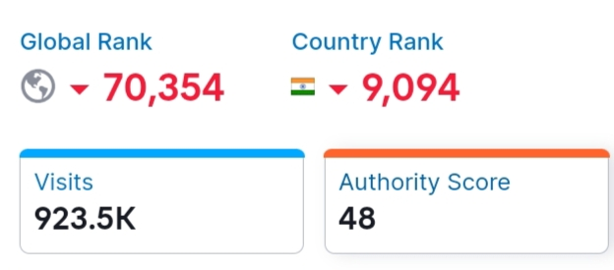
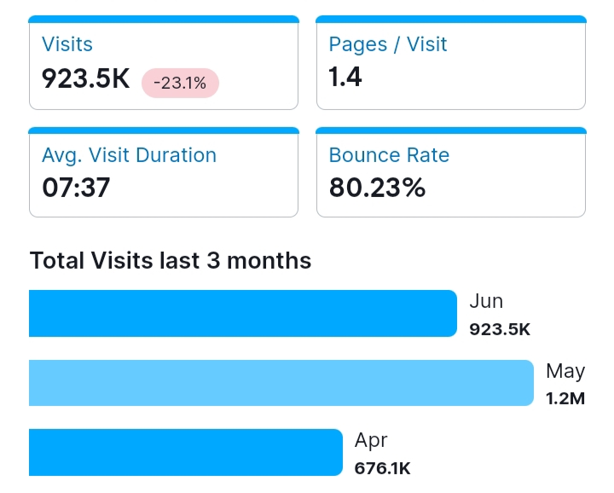
Part 2: Seo & keyword research
SEO Audit of Fabindia Website:

Slide 8

Keyword Research:
Fabindia Research Objectives: Fabindia links over 55,000 craft based rural producers to modern urban markets, thereby creating a base for skilled, sustainable rural employment, and preserving India’s traditional handicrafts in the process.
Brainstorm seed keywords: Seed keywords are words or phrases that you can use as the starting point in a keyword research process to unlock more keywords. Think of them as the building blocks of keywords research.

Slide 9
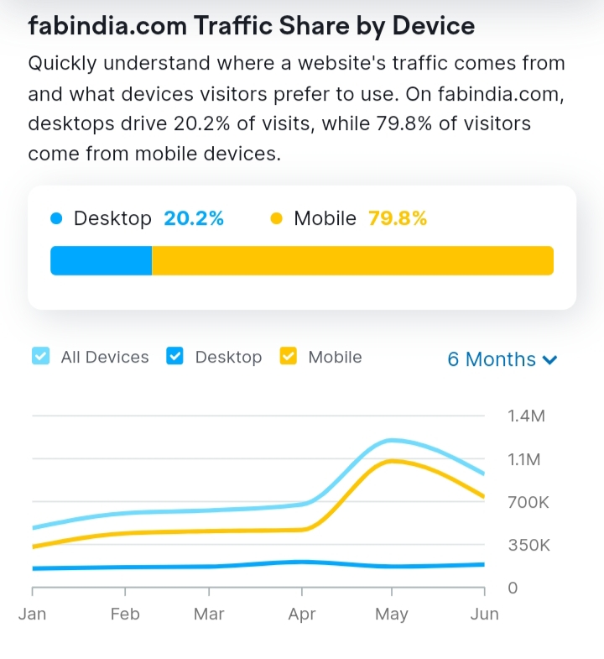
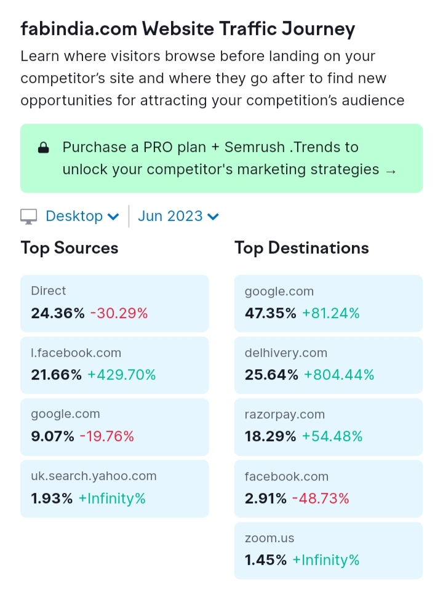
Keyword Research Tools: SEMRUSH

Slide 10


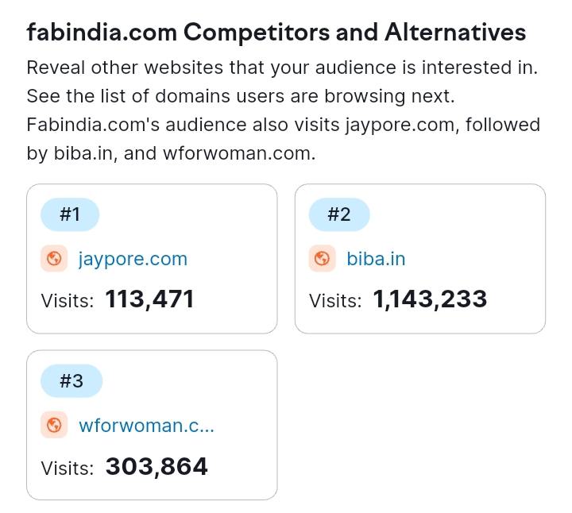
Analysis of Competitor keywords:

Slide 11

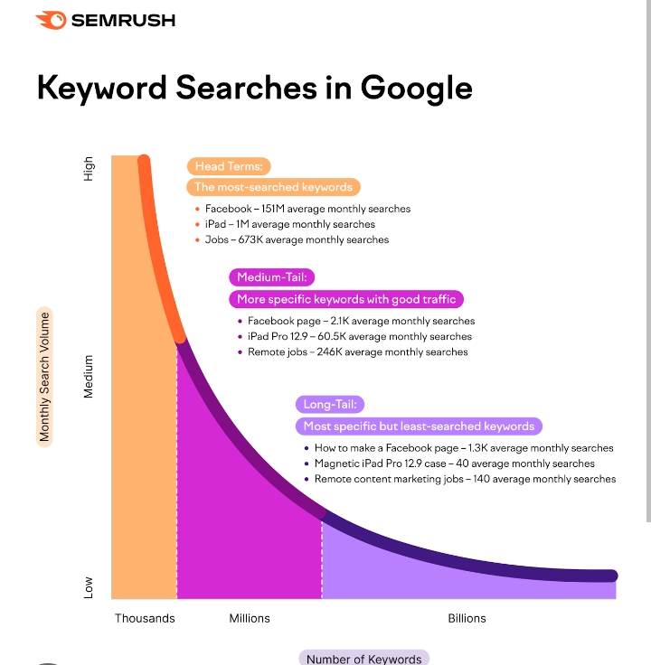
Long-tail Keywords:
For example, if we analyse the keyword “best content marketing podcasts,” we see that it has a low search volume and low keyword difficulty and also have lower competition but higher conversation potentiality which align with the research objectives. It’s also longer and highly specific. So, it’s a long-tail keyword. These are usually keywords closely related to the term you just searched for.

Slide 12

process of conducting keyword research and the SEO recommendations :
Keyword research is the process of finding and analysing keywords your ideal website visitors enter into search engines that enables you to target the most effective keywords in your content strategy. Keywords are words or phrases people use to find information or products in search engines. For example, if you want to buy food for your puppy you might type the keyword food for puppies into google properly conducted keyword helps you to:
Better understand your niche and target audience.
Tailor your content strategy to the needs of your audience.
Get more relevant traffic to your website.

Slide 13
Why is Keyword Research Important?
Keyword research allows you to discover terms related to a certain topic and uncover their search demand, difficulty score, intent and more.
From there, you can create content based on those words and topics, and get in front of your target audience by appearing on the Google search engine results pages (SERPs) with the content you know they’re looking for.
You can’t create content on a whim and hope that it performs well – you need to create data-supported content that you know will perform properly for the right target audience.
This is where keyword analysis goes hand-in-hand with research.

Slide 14

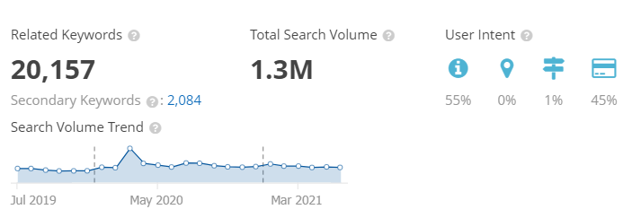

Slide 15
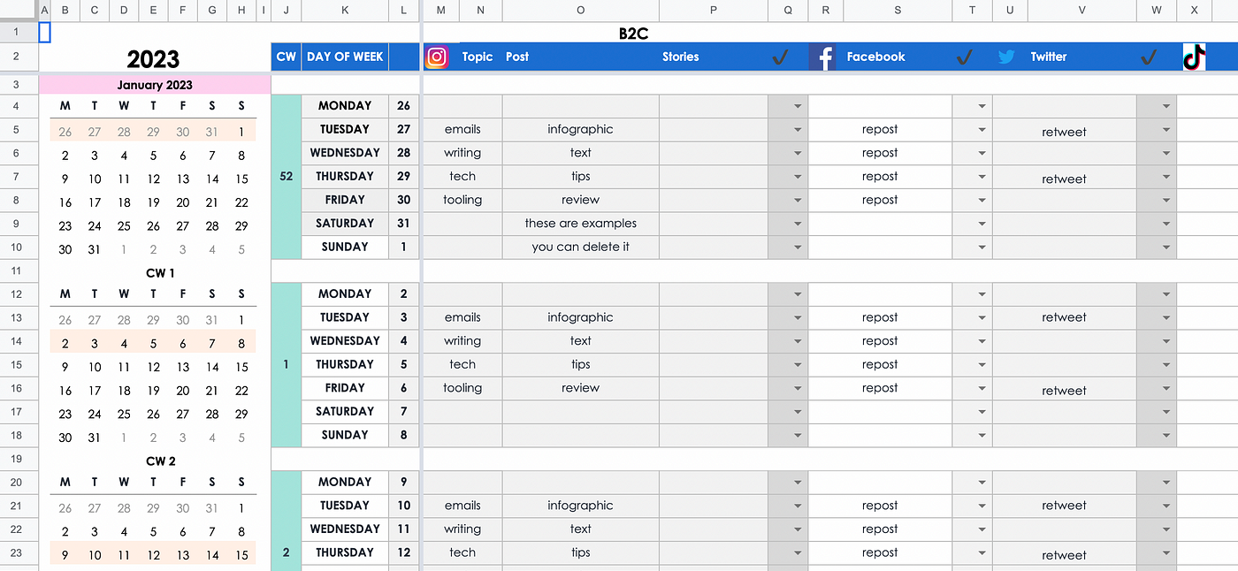
Part 3: Content Ideas and Marketing Strategies CONTENT CALENDAR
JULY

Slide 16

Strategy, Aim and the Idea behind these posts and stories
Ensures consistency: Content calendar lays out all your marketing activities including past, present and future, so you can better see how each activity relates to the others. This feature allows you to plan a more consistent schedule of activities – and make sure that they all work together to build your brand.
A content calendar is a resource to plan, schedule, and organize content creation and publishing. Marketing teams rely on their content calendars to plan campaigns across different platforms—like the company's blog, email marketing, and social networks.
A content calendar is important to keep your content marketing well-organized and on track. It helps you with initial brainstorming, which saves you from last-minute disastrous planning and helps you produce content consistently.
A social media calendar lets you plan ahead, batch your work, avoid multitasking, and note down all your content ideas for later. Social media planning calendar tools even allow you to schedule social media posts ahead of time.

Slide 17
Content, Ideas & Marketing strategies process
Adopt a unique angle with your content. Know Your Audience.
Tap into current trends.
Build evergreen content.
Nurture your email subscribers.
Create original research.
Write your case studies.
Build Interactive Tools.

Slide 18
Testimonials and Reviews.
Repurpose content.
Update old content.
Encourage user-generated content.
Guest Blogging.
Create videos on social media.
Host a podcast.
Offer lead magnets in exchange for email.

Slide 19
Challenges encountered and lessons learned in marketing strategies
Recruiting talent.
Maintaining a sufficient budget.
Generating leads. ...
Finding the right tools.
Being risk-averse.
Moving into new markets.
Retaining customers.
Retaining and training staff.
Choosing effective tactics.
Facing increased competition.

Slide 20

Part 4: Content Creation and Curation Post Creation

Slide 21





Slide 22

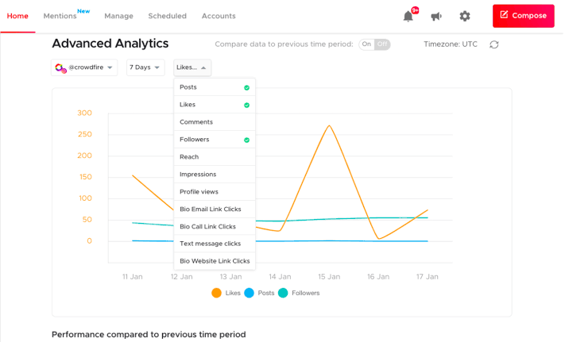
Insight Tool Analyse

Slide 23


Video Creation

Slide 24
Video Link
https://www.canva.com/design/DAFqBI3yN_s/61XgTDPx09QPMM9cafAKhw/edit?utm_content=DAFqBI3yN_s&utm_campaign=designshare&utm_medium=link2&utm_source=sharebutton

Slide 25

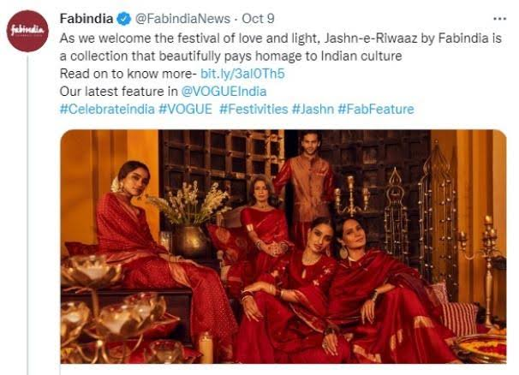
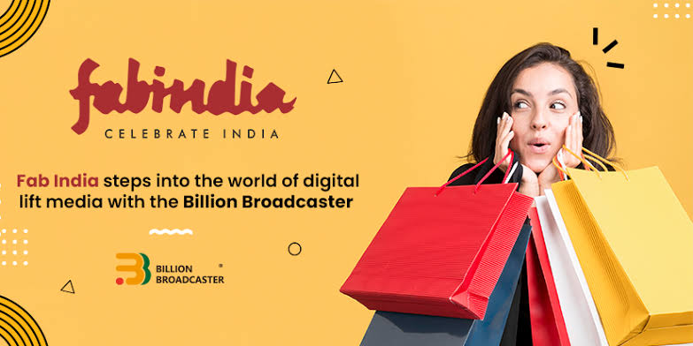
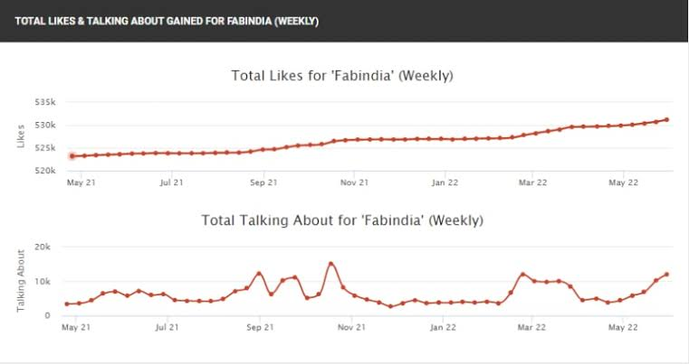
Social Media Ad Campaigns

Slide 26

Advertising Goals. Brand Awareness: Brand awareness refers to the level of familiarity consumers have with a particular brand. It is measured by how well consumers can recognize the brand's logo, name, products, and other assets. Driving website traffic: Website traffic refers to the volume of users visiting a website. How many people visit a website will depend on the website's purpose, the visitors' own goals, and the way in which they discovered the site. Generating leads: Lead generation is the process of generating consumer interest for a product or service with the goal of turning that interest into a sale. In online marketing this typically involves collecting a visitor's contact information (called a “lead”) via a web form.

Slide 27
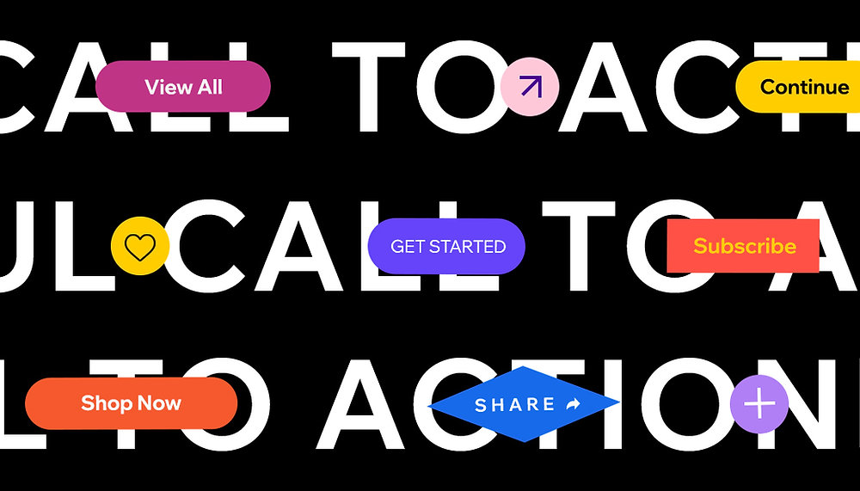

Visually appealing ad creatives, compelling ad copy and relevant call-to-action:

Slide 28
Email Ad Campaigns 1. Brand Awareness Understanding your target audience is the first step to building a successful email marketing campaign that builds brand awareness. It means taking the time to identify who your ideal customer is, what their interests are, and what they're looking for in a product or service. 2. Generation lead Email lead generation involves gathering potential customer information via an opt-in form that typically requests a name and email address. This helps build an email list for future marketing campaigns, allowing businesses to target interested individuals and nurture them through the sales funnel.

Slide 29

Email Ad Campaign 1
Brand Awareness

Slide 30
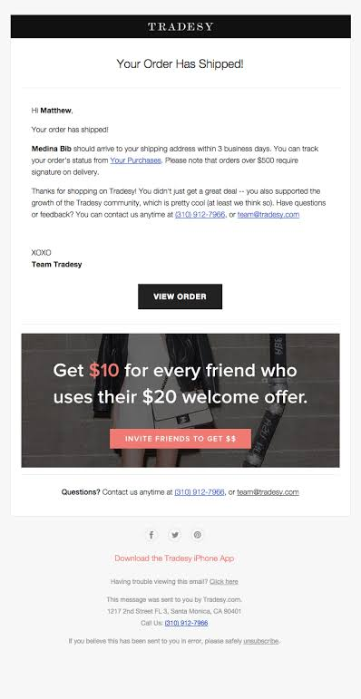
Email Ad Campaign 2
Generation lead

Slide 31
Content Creation and Curation Process Essentially, content curation relates to finding, filtering, and sharing relevant content created by others with your audience. On the other hand, content creation is what it sounds like – creating new content for your audience.
Challenges faced and lessons learned:
Producing high-quality content.
Generating content consistently.
Prioritising content expertise.
Understanding different buyer personas.
Producing content in suitable formats.
Measuring content ROI.
Creating buy-in among stakeholders.

Slide 32


